Slide 1
Data Preparation of Sensor Data
Project Wheels

Slide 2
Table of Content
Why prepare data?
Data Cleansing
Data Augementation
Jupyter Challenge

Slide 3
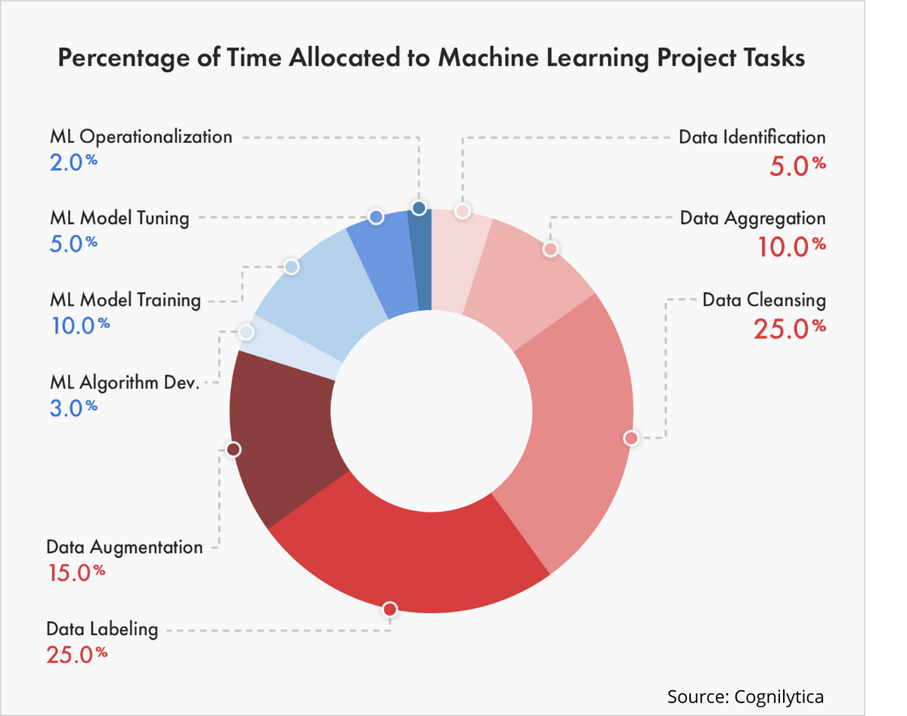
Why prepare data?
Most important step in Machine Learning
Must be done before model training
Big impact on accuracy/recall/precision

Slide 4
Data Cleaning
 | Acceleration | Temperature | Fuel | Action
1 | 3.52 | 20 | 4.31 | Acceleration
2 | 3.52 | 21 | 4.21 | Acceleration
3 | 1.34 | 20 | 4.18 | Acceleration
4 | 0.00 | 21 | NaN | Steady
5 | -0.34 | 20 | 4.16 | Deceleration

Slide 5
Data Cleaning
 | Acceleration | Temperature | Fuel | Action
1 | 3.52 | 20 | 4.31 | Acceleration
2 | 3.52 | 21 | 4.21 | Acceleration
3 | 1.34 | 20 | 4.18 | Acceleration
4 | 0.00 | 21 | 0 | Steady
5 | -0.34 | 20 | 4.16 | Deceleration

Slide 6
Data Labeling
 | Acceleration | Temperature | Fuel | Action
1 | 3.52 | 20 | 4.31 | Acceleration
2 | 3.52 | 21 | 4.21 | Acceleration
3 | 1.34 | 20 | 4.18 | Acceleration
4 | 0.00 | 21 | 0 | Steady
5 | -0.34 | 20 | 4.16 | Deceleration

Slide 7
Data Labeling
 | Acceleration | Temperature | Fuel | Action
1 | 3.52 | 20 | 4.31 | 2
2 | 3.52 | 21 | 4.21 | 2
3 | 1.34 | 20 | 4.18 | 2
4 | 0.00 | 21 | 0 | 1
5 | -0.34 | 20 | 4.16 | 0

Slide 8
Balancing
 | Acceleration | Temperature | Fuel | Action
1 | 3.52 | 20 | 4.31 | 2
2 | 3.52 | 21 | 4.21 | 2
3 | 1.34 | 20 | 4.18 | 2
4 | 0.00 | 21 | 0 | 1
5 | 0.00 | 21 | 0 | 1
6 | 0.00 | 21 | 0 | 1
7 | -0.34 | 20 | 4.16 | 0
8 | -0.34 | 20 | 4.16 | 0
9 | -0.34 | 20 | 4.16 | 0

Slide 9
Data Augmentation
Balancing
Low-Pass filter
Multiplying
Dividing
Polynomials
Differentials

Slide 10
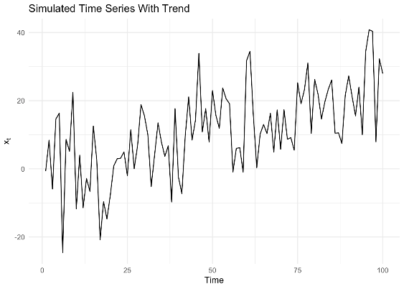
Low-Pass filter
https://bookdown.org/rdpeng/timeseriesbook/filtering-time-series.html

Slide 11
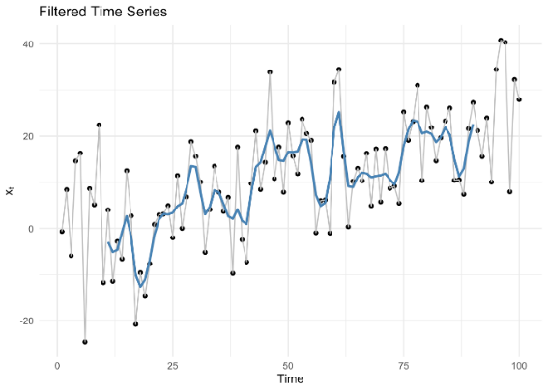
Low-Pass filter
https://bookdown.org/rdpeng/timeseriesbook/filtering-time-series.html

Slide 12
Mathematical Function
Multiplying
Dividing
Polynomials
Differentials

Slide 13
Jupyter
18094627@student.hhs.nl (Search Martijn Kok)
Deadline Friday this week
Best Accuracy

Slide 14
Questions

